Slide 1
BUSINESS CORRESPONDENCE
SHIVANI ARORA- (PDP Dept GEHU.)

Slide 2
Introduction To Business Correspondence
In our day to-day life we exchange our ideas, thoughts and other information with our friends, relatives and other people. Sometimes we directly talk to them and sometimes we also write letters to them. In letters we express our feelings in a few words, we may ask for any information or we may write about a complaint in connection with our problems. Similarly businessmen also exchange ideas, information by writing letters. They communicate business information to customers, suppliers and others and at the same time receive a variety of letters from them. In this lesson let us know about different types of letters used in the process of business transactions.

Slide 3
Meaning of Business Correspondence
Communication through exchange of letters is known as correspondence. We communicate our feelings, thoughts etc. to our friends and relatives through letters that may be called personal correspondence. A Businessman also writes and receives letters in his day to –day transactions, which may be called business correspondence. Business correspondence or business letters is a written communication between two parties. Businessmen may write letters to supplier of goods and also receive letters from the suppliers. Customers may write letters to businessmen seeking information about availability of goods, price, quality, sample etc. or place order for purchase of goods. Thus, business letters may be defined as a media or means through which views are expressed and ideas or information is communicated in writing in the process of business activities.

Slide 4
Principles of Effective Business Correspondence
Completeness: The communication must be complete. It should convey all facts required by the audience. The sender of the message must take into consideration the receiver’s mind set and convey the message accordingly.
Conciseness: Conciseness means wordiness, i.e., communicating what you want to convey in least possible words without forgoing the other C’s of Communication. Conciseness is a necessity for effective communication.
Consideration: Effective communication must take the audience into consideration, i.e., the audience’s view points, background, mind-set, education level, etc. Modify words in message considering audience’s needs while making the message complete.

Slide 5
Clarity: Clarity implies emphasizing on a specific message or goal at a time, rather than trying to achieve too much at once. Clarity makes understanding easier.
Concreteness: Concrete communication implies being particular and clear rather than fuzzy and general. Concreteness strengthens the confidence. It is supported with specific facts and figures. It makes use of words that are clear and that build the reputation. Concrete messages are not misinterpreted.
Courtesy: Courtesy in message implies the message should show the sender’s expression as well as should respect the receiver. The sender of the message should be sincerely polite, judicious, reflective and enthusiastic. Courteous message is positive and focused on the audience.
Correctness: Correctness in communication implies that there are no grammatical errors in communication. The message is exact, correct and well timed. It makes use of appropriate and correct language in the message. Correct messages has greater impact on the audience.

Slide 6
Importance of Business Correspondence
Now –a-days business operations are not restricted to any locality, state or nation. Today production takes place in one area but consumption takes place everywhere. Since the businessmen as well as customers live in far off places they don’t have sufficient time to contact each other personally. Thus, there arises the need for writing letters. In the past the situation was not so. Business letters were not essential in olden days. But now the importance of letters has increased because of vast expansion of business, increase in demand as well as supply of goods.
Following are the importance of business letters:

Slide 7
Help In Maintaining Proper Relationship: Now a days business activities are not confined to any one area or locality. The businessmen as well as customers are scattered throughout the country. Thus , there is a need to maintain proper relationship among them by using appropriate means of communication. Here business letters play an important role. The customers can write letters to the businessman seeking information about products and businessmen also supply various information to customers. This helps them to carry on business on national and international basis.
Inexpensive And Convenient Mode: Though there are modes of communication like telephone, telex, fax, etc. but business information can be provided and obtained economically and conveniently through letters.
Serves As Evidence: We cannot expect a trader to memorize all facts and figures in a conversation that normally takes place among businessmen. Through letters, he can keep a record of all facts. Thus, letters can serve as evidence in case of dispute between two parties.

Slide 8
Create And Maintain Goodwill: Sometimes business letters are written to create and enhance goodwill. Businessmen at times send letters to enquire about complaints and suggestions of their customers. They also send letters to inform the customers about the availability of a new product , clearance sale etc. All this results in cordial relations with the customers, which enhances the goodwill of the business.
Help In Expansion Of Business: Business requires information regarding competing products, prevailing prices, promotion, market activities, etc. If the trader has to run from place to place to get information, he will end up doing nothing. It will simply result in loss of time. But through business letters, he can make all enquiries about the products and markets. He can also receive orders from different countries and, thus enhance sales.

Slide 9
Structure of Business Correspondence Or Business Letter
The quality will be maintained if we give proper attention to each and every part of the letter. Let us now learn about the different parts or structure of a business letter.
The essential parts of a business letter are as follows:
Heading: The heading of a business letter usually contains the name and postal address of the business, E-mail address, Web-site address, Telephone Number, Fax Number, Trade Mark or logo of the business (if any)
Date: The date is normally written on the right hand side corner after the heading as the day, month and years. Some examples are 28th Feb., 2003 or Feb. 28, 2003

Slide 10
Reference: It indicates letter number and the department from where the letter is being sent and the year. It helps in future reference. This reference number is given on the left hand corner after the heading. For example, we can write reference number as AB/FA Dept./2003/27.
Inside Address: This includes the name and full address of the person or the firm to whom the letter is to be sent. This is written on the left hand side of the sheet below the reference number. Letter should be addressed to the responsible head e.g., the Secretary, the Principal, the Chairman, the Manager etc.
Subject: It is a statement in brief , that indicates the matter to which the letter relates. It attracts the attention of the receiver immediately and helps him to know quickly what the letter is about. For example,
Subject: Your order No C317/8 dated 12th March 2003.
Subject: Enquiry about Samsung television.
Subject: Fire Insurance policy

Slide 11
Salutation: This is placed below the inside address. It is usually followed by a comma (,). Various forms of salutation are:
Sir/Madam: For official and formal correspondence
Dear Sir/Madam: For addressing an individual
Dear Sirs/Dear Madam: For addressing a firm or company.
Body Of The Letter: This comes after salutation. This is the main part of the letter and it contains actual message of the sender. It is divided into three parts.
(a) Opening Part: It is the introductory part of the letter. In this part, attention of the reader should be drawn to the previous correspondence, if any. For Example- with reference to your letter no. 326 dated. 12th March 2003, I would like to draw your attention towards the new brand of television.

Slide 12
(b)Main Part: This part usually contains the subject matter of the letter. It should be precise and written in clear words.
(c) Concluding Part: It contains a statement the of sender’s intentions, hopes or expectations concerning the next step to be taken. Further, the sender should always look forward to getting a positive response. At the end, terms like Thanking you, With regards, With warm regards may be used.
Complimentary close: It is merely a polite way of ending a letter. It must be in accordance with the salutation. For Example:
Salutation Complementary close
1- Dear Sir/Madam Yours faithfully
2- Dear Mr. Raj Yours sincerely
3- My Dear Akbar Yours very sincerely (express very
informal relations. )

Slide 13
Signature: It is written in ink, immediately below the complimentary close. As far as possible, the signature should be legible. The name of the writer should be typed name. Where no letterhead is in use, the name of the company too could be included below the designation of the writer. For example:
Yours faithfully
For M/S Akron Electricals
(Signature)
SUNIL KUMAR
Partner
Enclosures: This is required when some documents like cheque, bills, receipts, lists, invoices etc. are attached with the letter. These enclosures are listed one by one in serial numbers. For example:
Encl: 1- The list of goods received
2- A cheque for Rs. One Thousand dtt. Feb. 27,2003
(Cheque No……) towards payment for goods supplied.

Slide 14
Copy Circulation: This is required when copies of the letter are also sent to persons apart of the addressee. It is denoted as C.C. For example,
C.C. 1- The Chairman, Electric Supply Corporation
2- The Director, Electric Supply Corporation
3- The Secretary, Electric Supply Corporation
Post Script: This is required when the writer wants to add something, which is not included in the body of the letter. It is expressed as P.S. For example,
P.S.- In our offer, we provide two years warranty.

Slide 15
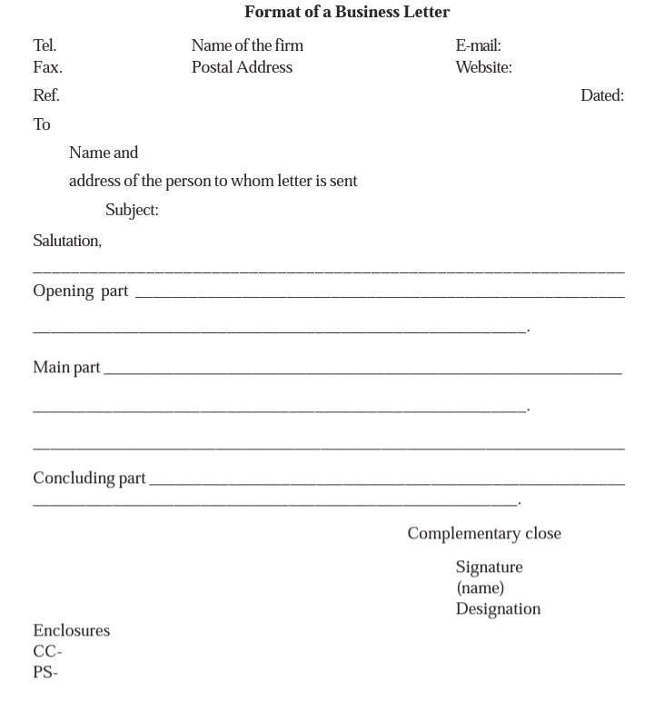

Slide 16
Type of Business Letters
Business letters are written for the fulfillment of several purposes. The purpose may be to enquire about a product to know it’s price and quality, availability, etc. This purpose is served if you write a letter of enquiry to the supplier. After receiving your letter the supplier may send you details about the product as per your query. If satisfied , you may give order for supply of goods as per your requirement. After receiving the items, if you find that the product is defective or damaged, you may lodge a complaint. These are the few instances in which business correspondence takes place.
Following are the details about some important business letters:

Slide 17
Business Enquiry Letter
Sometimes prospective buyers want to know the details of the goods which they want to buy, like quality, quantity, price, mode of delivery and payment, etc. The may also ask for a sample. The letter written to sellers with one or more of the above purposes is known as enquiry letter.
Points to be considered while writing a complaint letter-
Complaint letters should be written immediately after receiving the defective goods.
Mistakes as well as difficulty due to mistake should be mentioned clearly.
Proposal to correct the mistakes should be made.
Suggestions on how the complaint should be dealt with, i.e., mention of compensation, replacement, discount, cancellation etc, should be made.
Mention period in which the corrective action should be taken.
Request to be careful in future.

Slide 18
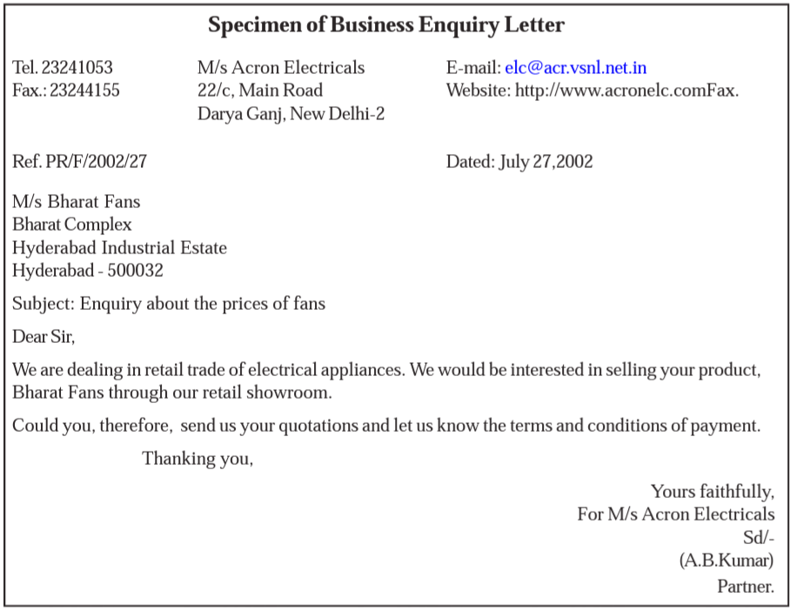

Slide 19
Quotation Letter
After receiving the letter of enquiry from a prospective buyer, the sellers supply the relevant information by writing a letter that is called quotation letter. These letters are written keeping in view the information asked for like price list, mode of payment, discount to be allowed etc. Businessman should reply to the inquiries carefully and promptly.

Slide 20
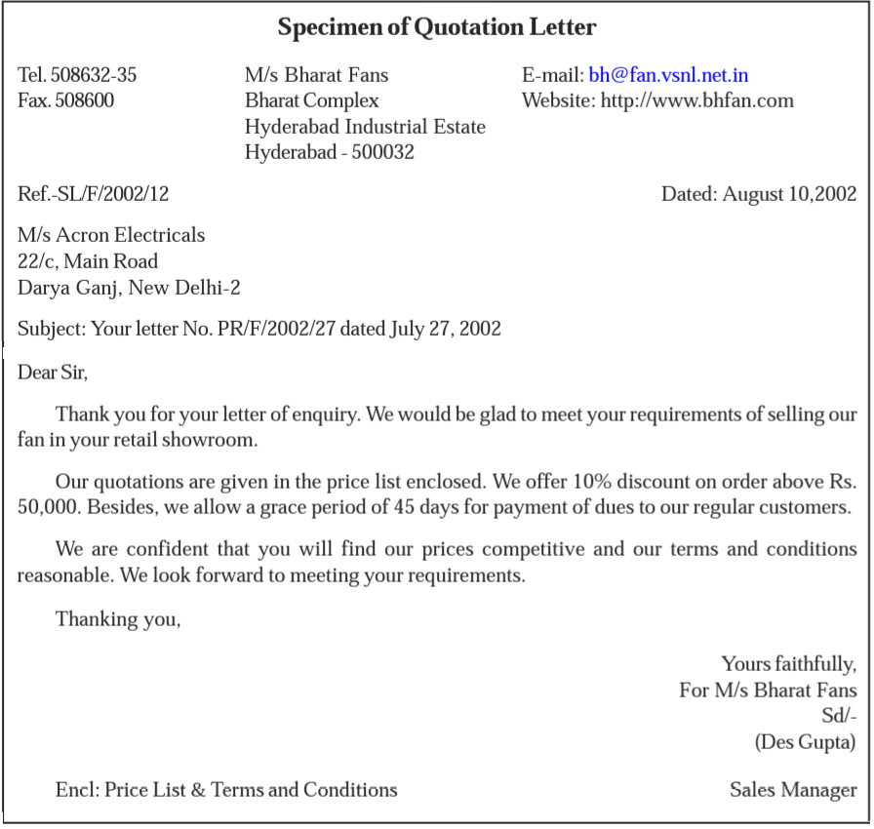

Slide 21
Order Letter
In the previous section, we have studied about letters of enquiry and reply to enquiry i.e., quotation letter. The prospective buyer after receiving the reply to his enquiry letter may decide to place on order with that business house which offers goods at minimum price and at favorable terms and conditions. Letters written by a buyer to the seller giving the order to purchase the goods is called order letter.

Slide 22
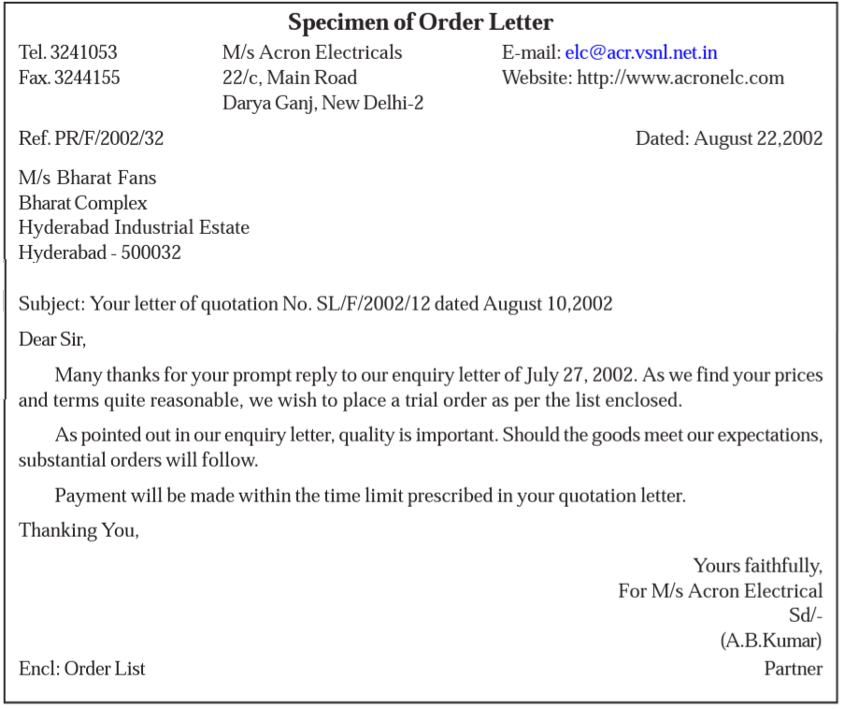

Slide 23
Complaint Letter
A complaint letter is written when the purchaser does not find the goods up to his satisfaction. It is normally written by the purchaser when he receives wrong, defective or damaged goods or receives incorrect quantity of goods. It can also be written directly to the transit authority when the goods are damaged in transit. Thus, we may define a letter of complaint as letter that draws the attention of the supplier or any other party on account of supply of defective or damaged goods.

Slide 24
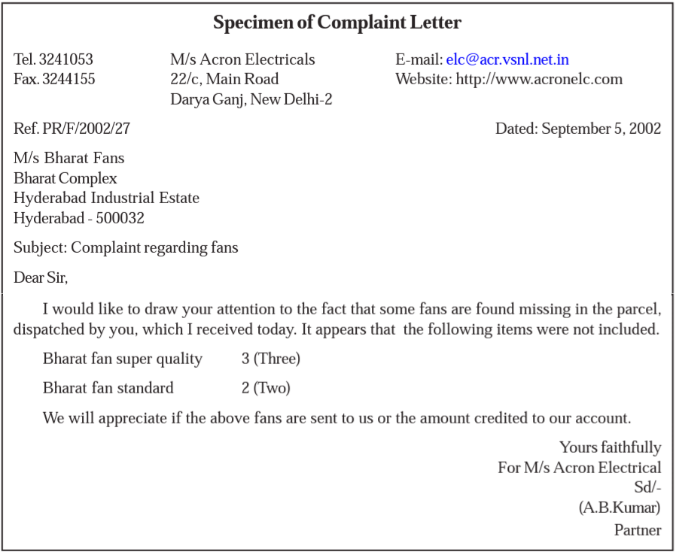

Slide 25
Recovery Letter
The letter written by seller for collection of money for the goods supplied to the buyer is called recovery letter. The aim of recovery letter is to collect money without annoying the customers. The letter should include information regarding the amount of arrears argument for payment, and last date for payment. The language of recovery letter should be polite, so that the customers is not offended and future transactions with him are not adversely affected.

Slide 26
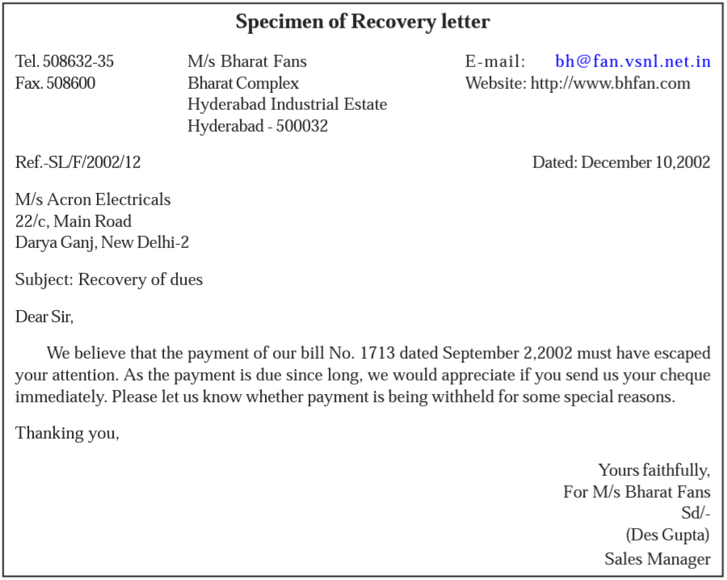

Slide 27
Guidelines Of A Good Business Letter
A letter should serve the purpose for which it is written. If a businessman writes a letter to the supplier for purchase of goods, the letter should contain all the relevant information relating to the product, mode of payment, packaging, transportation of goods, etc. clearly and specifically. Otherwise, there will be confusion that may cause delay in getting the goods. Again the quality of paper used in the letter, its size, color etc. also need special attention, because it creates a positive impression in the mind of the receiver. We may classify the guidelines of a good business letter as:
a. Inner Guidelines; and
b. Outer Guidelines

Slide 28
a)- Inner Guidelines- The inner qualities of a good business letter refer to the quality of language, it’s presentation, etc. These facilitate quick processing of the request and that leads to prompt action. Let us discuss the various inner qualities of a good business letter.
Simplicity- Simple and easy language should be used for writing business letters. Difficult words should be strictly avoided, as one cannot expect the reader to refer to the dictionary every time while reading letter.
Clarity- The language should be clear, so that the receiver will understand the message immediately, easily and correctly. Ambiguous language creates confusion. The letter will serve the receiver understands it in the same manner in which it is intended by the sender.

Slide 29
Accuracy- The statements written in the letter should be accurate to, the best of the sender’s knowledge. Accuracy demands that there are no errors in the usage of language – in grammar, spellings, punctuations etc. An accurate letter is always appreciated.
Relevance- The letter should contain only essential information. Irrelevant information should not be mentioned while sending any business correspondence.
Neatness- A neat letter is always impressive. A letter either handwriting or typed, should be neat and attractive in appearance. Overwriting and cuttings should be avoided.
Courtesy- Courtesy wins the heart of the reader. In business letter, courtesy can be shown/expressed by using words like please, thank you, etc.

Slide 30
b)- Outer Guidelines- The outer qualities of a good business letter refers to the appearance of the letter. It includes the quality of paper used, color of the paper, size of the paper etc. Good quality paper gives a favorable impression in the mind of the reader. It also helps in documenting the letters properly. Let us discuss the various outer qualities of a good business letter.
Quality of Paper- The paper used should be in accordance with the economic status of the firm. Now-a-days the cost of the paper is very high. Therefore, good paper should be used for original copy and ordinary paper may be used for duplicate copy.
Color of The Paper- It is better to use different colors for different types of letters, so that the receiver will identify the letters quickly and prompt action can be taken.

Slide 31
Size of the Paper- Standard size paper (A4) should be used while writing business letters. The size of the paper should be in accordance with the envelopes available in the market.
Folding of Letter- The letter should be folded properly and uniformly. Care should be taken to give minimum folds to the letter so that it will fit the size of the envelope. If window envelope is used then folding should be done in such a way that the address of the receiver is clearly visible through the transparent part of the envelope.
Envelope- The size and quality of the envelope also need special attention. The size of the letter should fit the size of the letters. The business firms use different types of envelopes i.e., ordinary envelope, window envelope, laminated envelope etc. In window envelope there is no need to write the address of the receiver separately on the envelope. It is clearly visible through the transparent part on the face of the envelope, which may be called as window. In laminated envelope a thin plastic sheet or cloth is pasted on the inner side that gives extra protection to letters from being damaged during transit.

Slide 32
THE END

